Slide 1
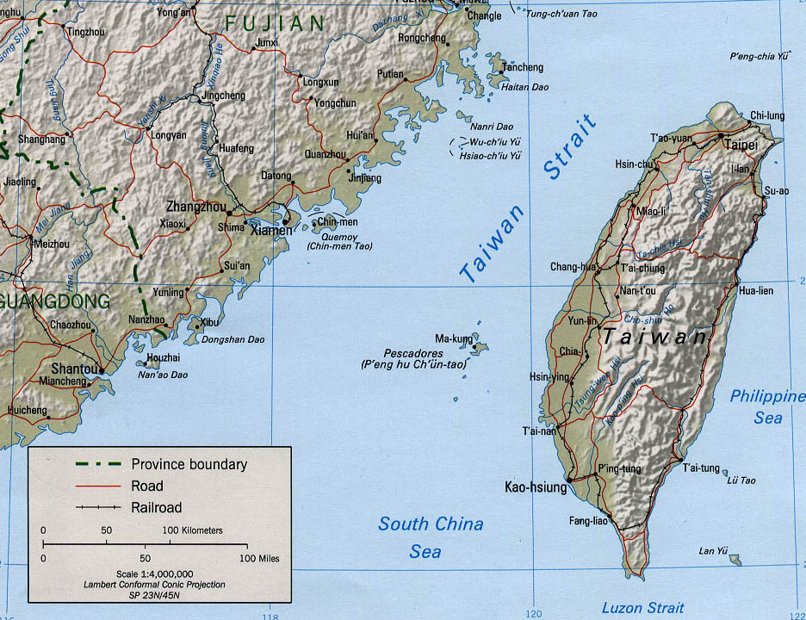
Wander in
Tour guides:
Jerrel Lai
Sveta Chang
Dexter Tiu
Allyn Nuevo
http://wps.aw.com/wps/media/objects/5446/5577111/Country_Maps/taiwan.jpg

Slide 2
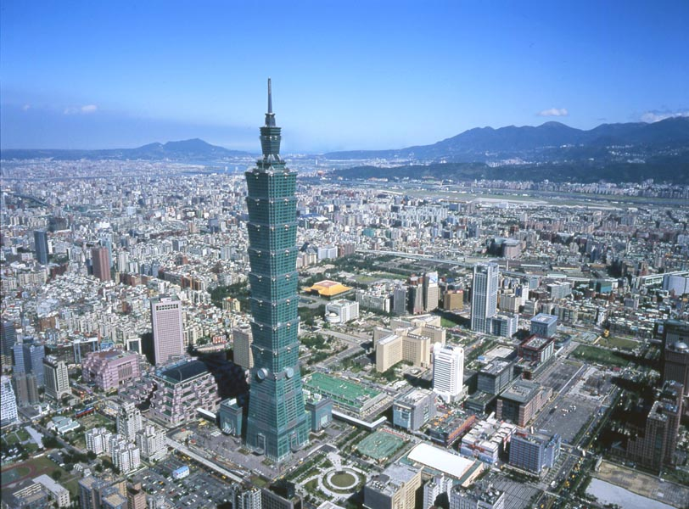
Let us embark on a tour around Taiwan!
Source: http://thebesttraveldestinations.com/wp-content/uploads/2011/01/taipei_101_taiwan_01-600x443.jpg

Slide 3
Day 1
Taipei
Speaker: Dexter Tiu

Slide 4
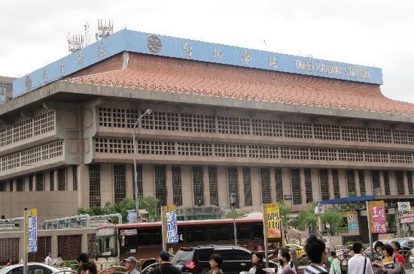
Starting Point:
Taipei Main Station
Source: http://media-cdn.tripadvisor.com/media/photo-s/01/51/e9/81/the-taipei-main-station.jpg

Slide 5
Morning:
Chiang Kai-shek Memorial Hall

Slide 6
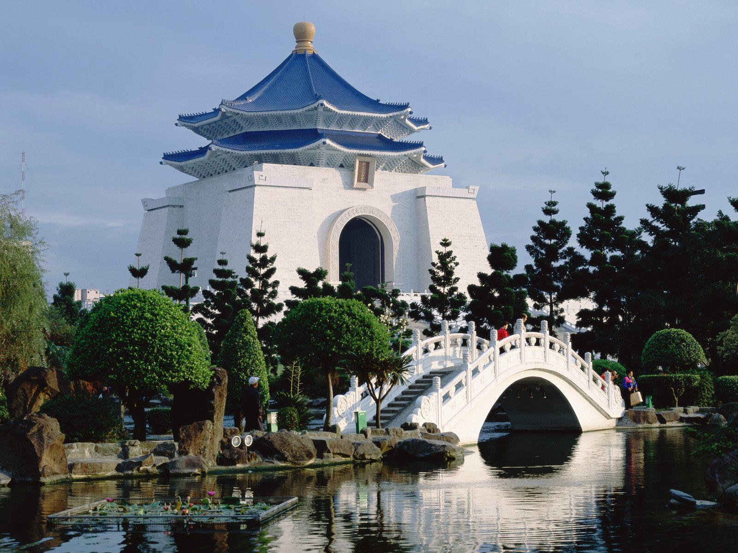
Chiang Kai-shek Memorial Hall
國立中正紀念堂
Source: http://www.globeimages.net/data/media/109/Chiang_Kai_Shek_Memorial_Hall_Taipei_Taiwan.jpg

Slide 7
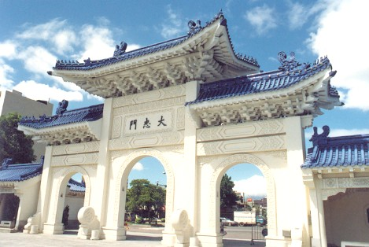
About Chiang Kai-shek Memorial Hall:
Tomb and shrine to famous leader Chiang Kai-shek
Symbol of Chinese democracy
What we can do:
Feel the spirit of Chinese culture and take note of architectural references:
Blue and white theme (Flag symbol)
89 steps (His age at death)
Liberty square (Pen name-Impartial and Righteous [中正])
Explore the halls to see his life through a multitude of photographs
Visit the park and see its rainwater recycling system
Source: http://www.joyeast.com/files/imagecache/city_photos/files/photos/small/Panorama_view.jpg
http://upload.wikimedia.org/wikipedia/commons/5/5c/CKS_Panorama.jpg

Slide 8
Afternoon:
National Palace Museum

Slide 9
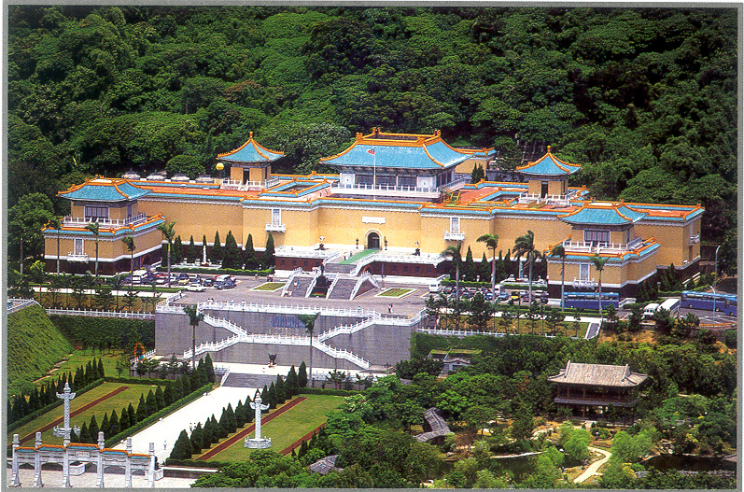
National Palace Museum
國立故宮博物院
Source: http://www.apdc2012.org/en/images/National%20Palace%20Museum.jpg

Slide 10
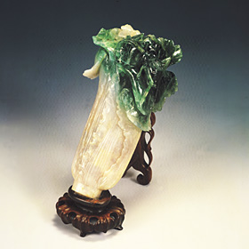
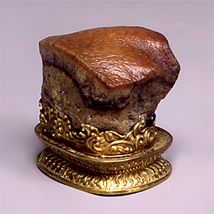
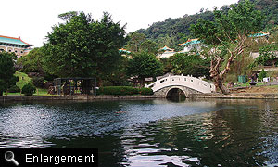
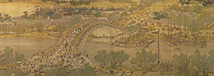
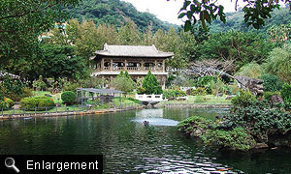
Jadeite Cabbage
About National Palace Museum:
Preservation of Chinese culture
Wealth of Chinese history
Things to do:
See rare artifacts in the permanent and special exhibition:
Jade, ceramics, and bronze wares
Paintings, calligraphy, and documents
Visit the pavilions and the black colored pond in Zhishan Garden
Meat-shaped Stone
http://www.npm.gov.tw/uploads/2006030905041395690/10_K1C002103N000000000AA.jpg
http://www.npm.gov.tw/uploads/2006031402131378515/14.jpg
http://www.npm.gov.tw/uploads/200602031147236447/31_K2A001110N000000000AA.jpg
http://www.npm.gov.tw/exh96/chih-shan/images/s_en_03.jpg
http://www.npm.gov.tw/exh96/chih-shan/images/s_en_08.jpg
Along the River During the Qingming Festival

Slide 11
Evening:
Taipei 101

Slide 12
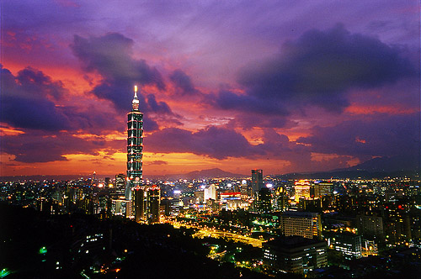
TAIPEI 101
臺北101
Source: http://eng.taiwan.net.tw/att/2/big_scenic_spots/pic_3469_4.jpg

Slide 13
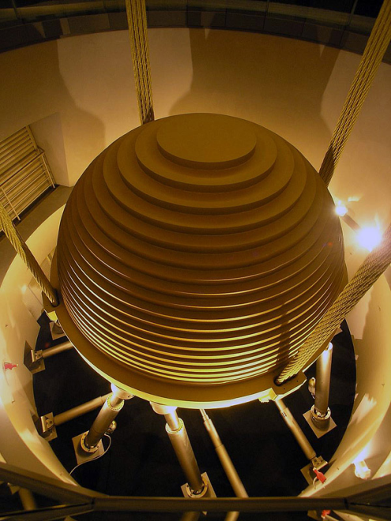
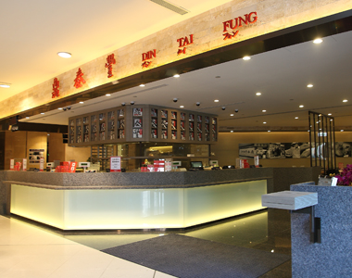
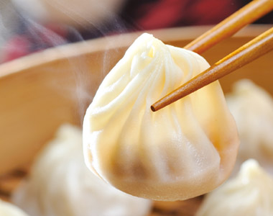
Tuned mass damper
About Taipei 101:
Taiwan’s progress in economy and technology
Features ancient motifs with modern technique
Resemblance to bamboo stalk and pagoda
Eight segments (8 being a lucky number)
Lights displaying one color of spectrum every night
Ruyi
Things we can do:
Dine at Din Tai Fung (鼎泰豐)
Go to observatory and observation deck (91st F)
Shop at the adjoining shopping mall
http://upload.wikimedia.org/wikipedia/commons/thumb/7/7c/Taipei_101_Tuned_Mass_Damper_2010.jpg/220px-Taipei_101_Tuned_Mass_Damper_2010.jpg
http://upload.wikimedia.org/wikipedia/commons/8/89/Taipei.101.ruyi.altonthompson.jpg
http://t1.gstatic.com/images?q=tbn:ANd9GcS_btPoQYquiBcNVvDVGoPhqeB3-ObkjEo5KO6A2pkLL3OBK8cvvA
http://www.dintaifung.com.tw/images/areas/101_06.jpg
http://www.dintaifung.com.tw/images/products/66-380x300.jpg
Din Tai Fung (鼎泰豐)
Xiaolongbao (小籠包) NT$160 for 10 pcs.

Slide 14
Shilin Night Market

Slide 15
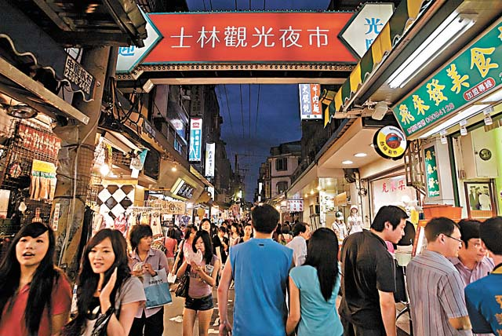
Shilin Night Market
Symbol:
People’s livelihood
Local Taste
Night Life
Things to do:
Eat local food
Buy goods at very low price!
Source: http://besttouristplace.com/wp-content/uploads/2011/06/Shilin-Night-Market.jpg

Slide 16
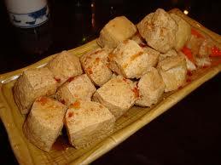
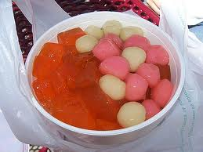
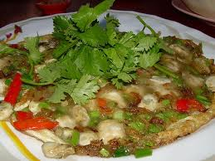
Stinky Tofu
Aiyu Jelly
Oyster Omelet
http://blogs.villagevoice.com/forkintheroad/DSC06179v.jpg
http://http.cdnlayer.com/smoola/00/00/56/2a3e54f40b9e2ab5_m.jpg
http://farm2.static.flickr.com/1327/910394471_5151284934.jpg

Slide 17
Day 2 & 3
Sun Moon Lake
Speaker: Allyn Nuevo

Slide 18
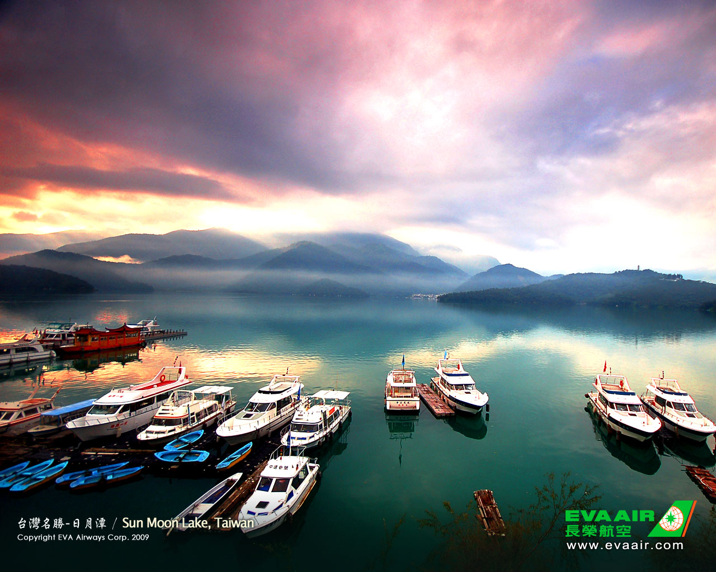
Sun Moon Lake
日月潭

Slide 19
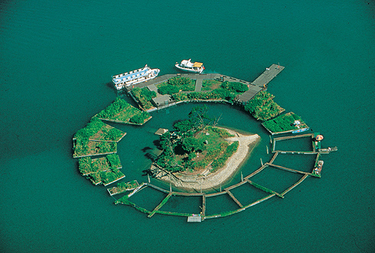
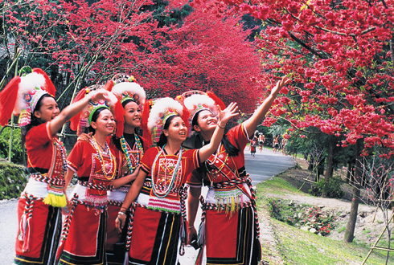
Interesting Facts About Sun Moon Lake:
Largest natural lake in Taiwan (800 hectares)
Divided by the tiny Lalu island(拉魯島)
East part of the lake is shaped like the sun and west part is shaped like a moon
Used to be a famous wedding venue until the most of the island sunk because of the 921 earthquake
Home to the Thao tribe(邵族)
Source: http://www.sunmoonlake.gov.tw

Slide 20
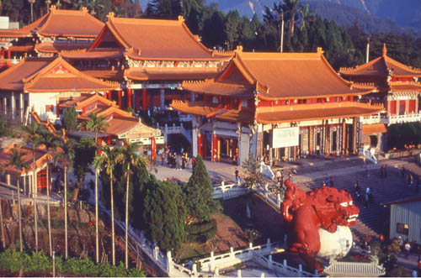
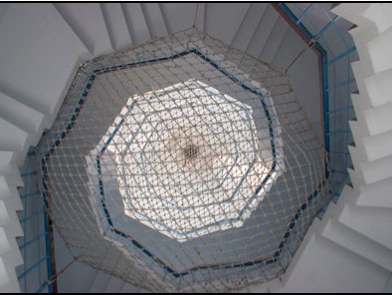
Things to do in Sun Moon Lake:
Visit Wenwu Temple(文武廟)!
Taoist Shrine
Great sunset view overlooking the lake
Palace style of northern China
The only temple in Taiwan that has a statue of Confucius
http://eng.taiwan.net.tw/att/2/small_scenic_spots/09947_011497_135-000347.jpg
Visit the TsenPagoda(慈恩塔)!
built in honor of Chiang Kai -Shek’s mother
9-story; traditional Chinese style
http://www.taiwanese-secrets.com/sun-moon-lake.html

Slide 21
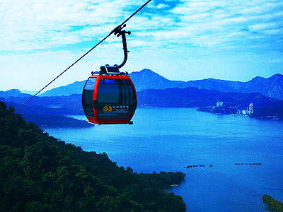
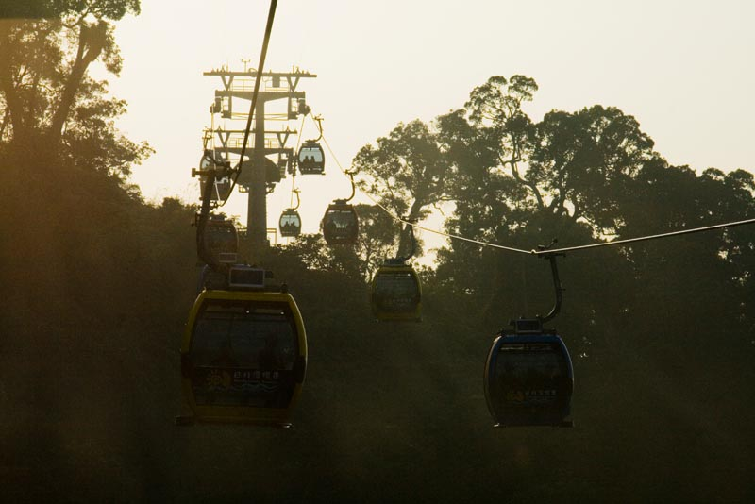
Things to do in Sun Moon Lake:
Ride the gondola!
Links the Sun Moon Lake to the Formosan Aboriginal Culture Village
Reached its three-millionth rider within just one year of operations
Cars painted in red, yellow & blue representing sun, moon & lake, respectively
http://tw.tranews.com/Show/images/News/3221587_1.jpg
http://www.flickr.com/photos/damon_tighe/4366349236/

Slide 22
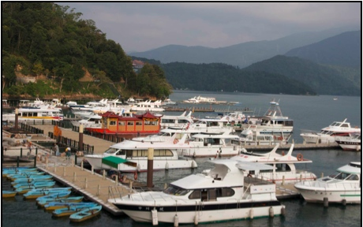
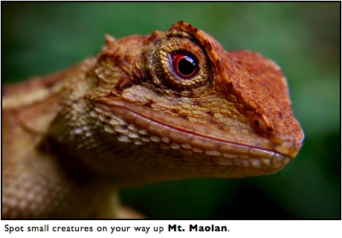
Things to do in Sun Moon Lake:
Rent a boat!
at the Shuishe pier
rowing to Lalu Island
NT$200 / hr
Boat cruises cost NT$300 for 45mins.
http://www.taiwanese-secrets.com/sun-moon-lake.html
Go on a hiking trail!
Mt. Maolan Trail(貓蘭山步道)
- 3km trail
- view of the vast tea plantations
Mt. Shuishe Trail(水社山步道)
- the summit is 2059m above sea-level
- best views of the lake
http://www.taiwanese-secrets.com/sun-moon-lake.html

Slide 23
Day 4 & 5
Tainan
Speaker: Jerrel Lai

Slide 24
How to get there:
Source: http://fangshiushiu.wordpress.com/2011/04/22/get-a-copy-of-your-taiwan-map-here-%E6%82%A8%E5%B9%B8%E7%A6%8F%E7%9A%84%E5%8F%B0%E7%81%A3%E5%9C%B0%E5%9C%96%EF%BD%9E/

Slide 25
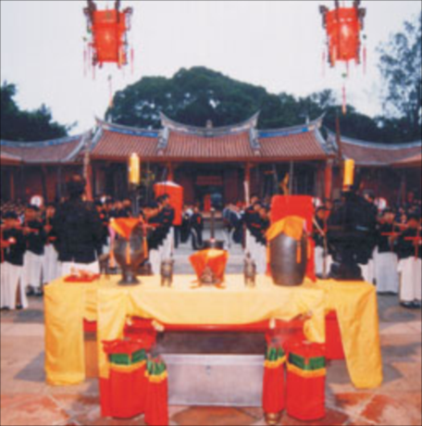
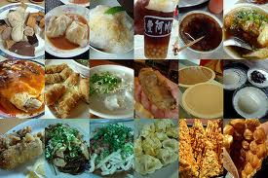
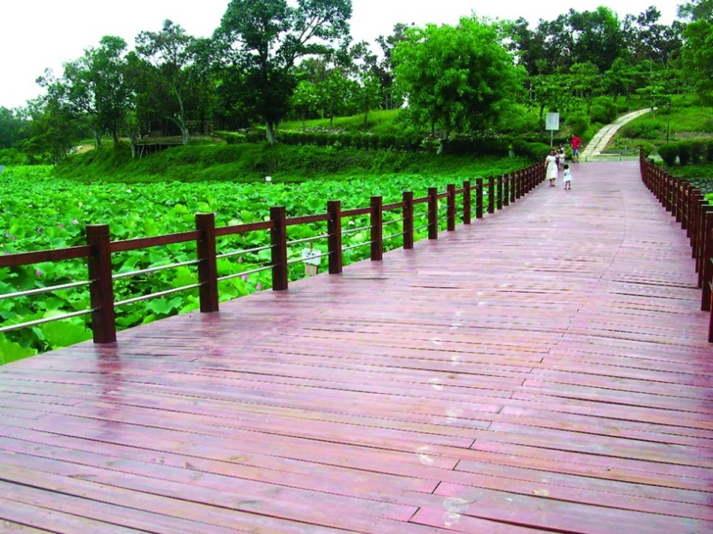
In Tainan, we will see…
History & Culture
Delicacies
Ecology and Animals
Relaxing & Scenery
http://tour.tainan.gov.tw/

Slide 26
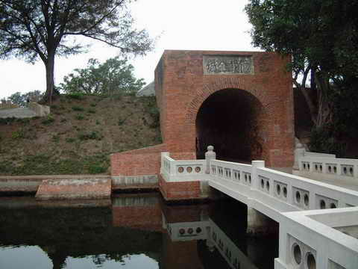
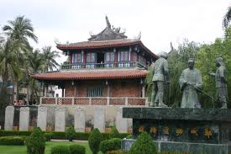
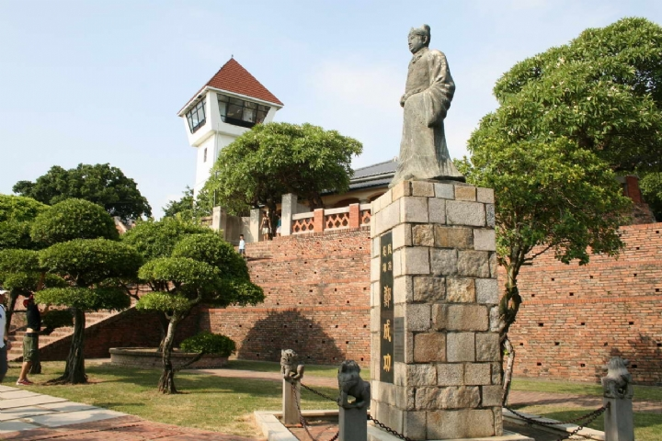
History of Hero stories
Day 4
Morning
1. The Eternal Castle (億載金城)
French design
The statue of Shen Baozhen (沈葆楨)
2. Chih Kan Tower (赤崁樓)
Holland culture and architectures
3. Anping Old Fort (安平古堡)
The oldest fort in Taiwan
The battle between Holland’s heroes & Ming heroes
Sources:
http://www.premier.com.tw/Touring/yizhaijincheng.htm
http://www.premier.com.tw/Touring/anpinggubao.htm
http://www.premier.com.tw/Touring/chikanlou.htm

Slide 27
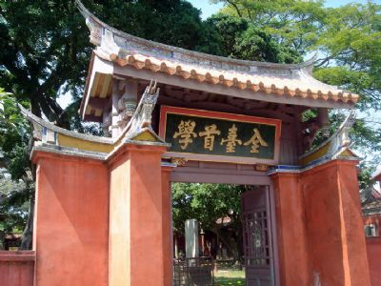
Tainan Confucian Temple
Source: http://travel.network.com.tw/tourguide/point/showpage/163.html

Slide 28
Where to Relax?
Baihe (白河) Lily Park
What you can do:
Go Picture-drawing
Go on a hiking path along the lily pool
Participate in Lotus Festival (from June to September)
Day 4
Afternoon
Source: http://tour.tainan.gov.tw/view.aspx?sn=140

Slide 29
Night Life in Tainan
Tainan Civil Square
What you can see:
Symphony performance
Light Water Dance
Tainan Public Art
Day 4
Evening
Source: http://tour.tainan.gov.tw/view.aspx?sn=24

Slide 30
What can you see in Tainan:
Day 5
The Salt Field and the biggest Lagoon of Taiwan
Various biodiversity, (over 23 endangered species of birds)
Have a close look at the Black-faced Spoonbill…
Cigu (七股) Lagoon
Black-faced Spoonbill
Source:
http://tour.tainan.gov.tw/view.aspx?sn=31

Slide 31
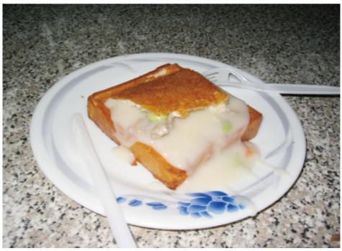
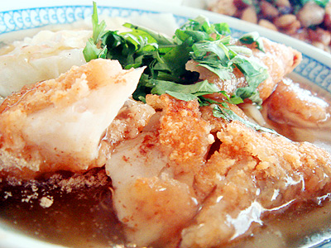
Must-Try Food in Tainan!
Coffin Sandwich
Mackerel Thick Soup
Sources:
http://0930218322.tw.tranews.com/ http://062223870.tw.tranews.com/

Slide 32
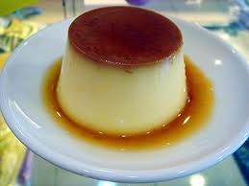
Must-Try Food in Tainan!
Eel Noodles
Caramel Pudding
Sources:
http://blog.xuite.net/maomi/Food01/32288601 http://tw.tranews.com/Show/Style1/News/c1_News.asp?SItemId=0271030&ProgramNo=A000001000002&SubjectNo=76934

Slide 33
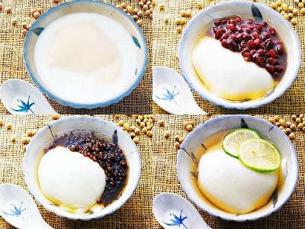
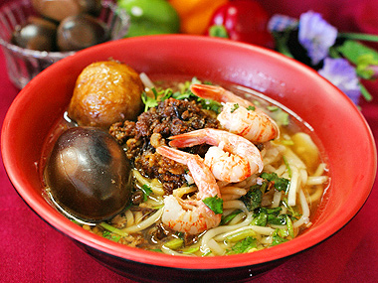
Must-Try Food in Tainan!
Soy Custard
Tu Hsiao Yueh Tann-ah Noodles
Sources:
http://7041.tw.tranews.com/Show/Style3/News/c2_News.asp?SItemId=0271030&ProgramNo=A100122000001&SubjectNo=78752 http://062215631.tw.tranews.com/

Slide 34
Day 6 & 7
Taitung & Hulaien
Speaker: Sveta Chang

Slide 35
Eastern Taiwan: Taitung & Hualien
Culture of the Indigenous Tribes
Renowned for the indigenous tribes (原住民)
The Bunun (布農) have their special octet (八部合音)
The Amis is the largest tribal group

Slide 36
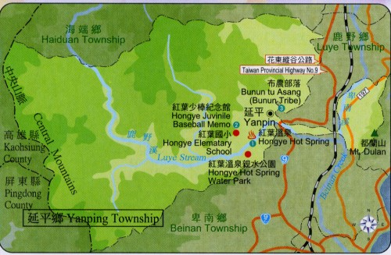
Directions
Take a train From Tainan(台南)
to Luye (鹿野) station
(Fee around $500)

Slide 37
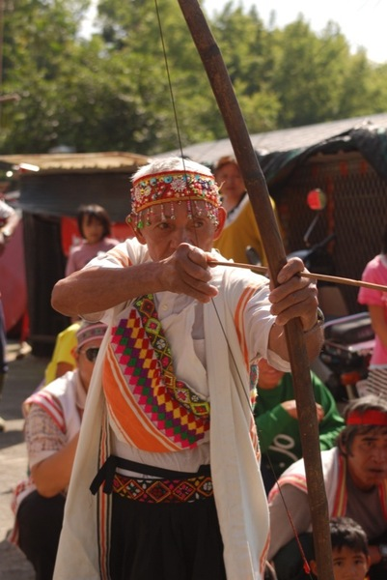
Things to do in Taitung
→ → → Yanping Township 延平鄉
Watch the Bunun tribe “Hitting the Ear” sacrifice
(布農族打耳祭)
“Ear” means the ear of deer
Done during April or May.
The most important celebration (for hunting)
A requirement for being an adult
Women cannot attend the ceremony
Visit
Source: http://tw.myblog.yahoo.com/jw!UJnOY0qEQE7r.eWL2VFmlkSU1g--/article?mid=1486

Slide 38
Directions
Take a train from Luye (鹿野) to Guangfu(光復) station
($200)

Slide 39
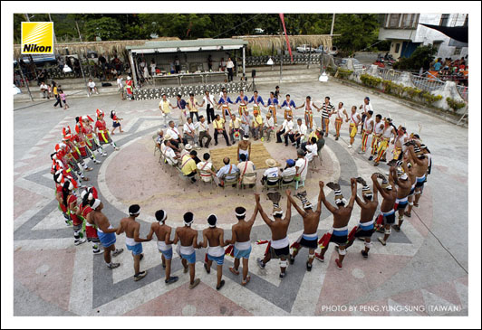
Things to do in Hualien
→ → Mataian Wetland 馬太鞍溼地
Watch the Amis Harvest Festival 阿美族豐年祭
In July or August
To celebrate the new year for the millet harvest
On the first day, women cannot attend the ceremony
Source: http://www.erv-nsa.gov.tw/user/Article.aspx?Lang=2&SNo=03000058

Slide 40
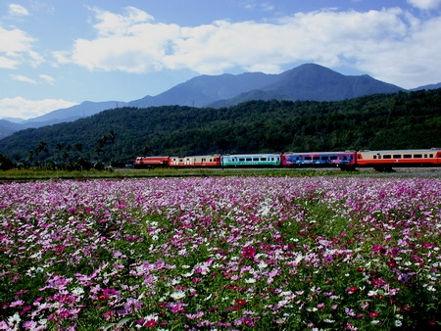
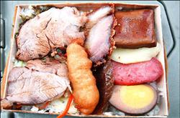
This is where our Taiwan tour ends… ☹
On our long train ride to Taipei, we can enjoy the Chihshang Biandong 池上便當 (boxed lunch).

Slide 41
Thank you for listening!
Hope you enjoyed your stay in Taiwan! ☺

Slide 42
REFERENCES:
http://wps.aw.com/wps/media/objects/5446/5577111/Country_Maps/taiwan.jpg
http://www.worldatlas.com/webimage/flags/countrys/zzzflags/twlarge.gif
http://earth.imagico.de/views/taiwan2_small.jpg
http://missions4taiwan.com/images/yanming2.jpg
http://www.filigallery.com/d/61806-2/Sun+Moon+Lake+Sunset+Shuishe+Village-16.JPG
http://farm3http://wps.aw.com/wps/media/objects/5446/5577111/Country_Maps/taiwan.jpg
http://zh.wikipedia.org/wiki/File:Nantou_Bus.jpg
http://images.travelpod.com/users/teamrocket8/2.1253567514.image_3.jpg
http://jordantan.com/wp-content/uploads/2010/10/IMG_5244.jpg
http://eng.taiwannet.tw/att/2/small_scenic_spots/09947_011497_135-000347.jpg
http://media-cdn.tripadvisor.com/media/photo-s/01/51/e9/81/the-taipei-main-station.jpg
http://farm3.static.flickr.com/2076/2222391524_03e814c93e_z.jpg
http://english.taipei.gov.tw/site/tcg/public/MMO/TCGENG/YMS_flower_close.JPG
http://www.twx.cc/uploadfile/content/2009090223271499.jpg
http://www.520ynly.com/UploadPhoto/Original/201105110349227168779.jpg
http://www.48hourvisit.com/wp-content/uploads/2010/05/Beitou-Hot-Springs-Museum.jpg

Slide 43
REFERENCES:
http://farm3.static.flickr.com/2500/4119486276_0c0b2e634e_m.jpg
http://farm1.hv-static.flickr.com/81/242903291_608c5cdda7.jpg
http://img78.exs.cx/img78/7419/013sb.jpg
http://myriammahiques.blogspot.com/2011/01/taipei-101-aims-to-be-worlds-tallest.html
http://english.taipei.gov.tw/site/tcg/public/MMO/TCGENG/YMS_flower_close.JPG
http://www.twx.cc/uploadfile/content/2009090223271499.jpg
http://www.520ynly.com/UploadPhoto/Original/201105110349227168779.jpg
http://www.48hourvisit.com/wp-content/uploads/2010/05/Beitou-Hot-Springs-Museum.jpg
http://farm3.static.flickr.com/2500/4119486276_0c0b2e634e_m.jpg
http://farm1.hv-static.flickr.com/81/242903291_608c5cdda7.jpg
http://www.imageenvision.com/cliparts/traveling
http://www.taiwanese-secrets.com/sun-moon-lake.html
http://www.ah-taiwan.com/pages/info.php/sun-moon-lake
http://tw.tranews.com/Show/images/News/3221587_1.jpg
http://www.flickr.com/photos/damon_tighe/4366349236/
http://tw.tranews.com/Show/Style1/News/c1_News.asp?SItemId=0271030&ProgramNo=A000203000001&SubjectNo=3221587
http://www.sunmoonlake.gov.tw/en/03000573.aspx

